Slide 1

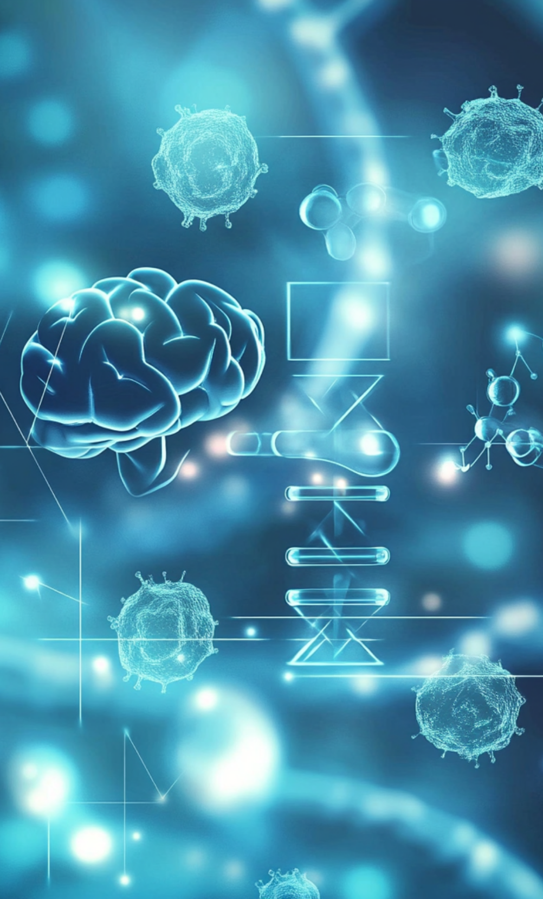
Learning to Label and classify the data
From Clustering to Classification
Date: 16th May 2025

Slide 2

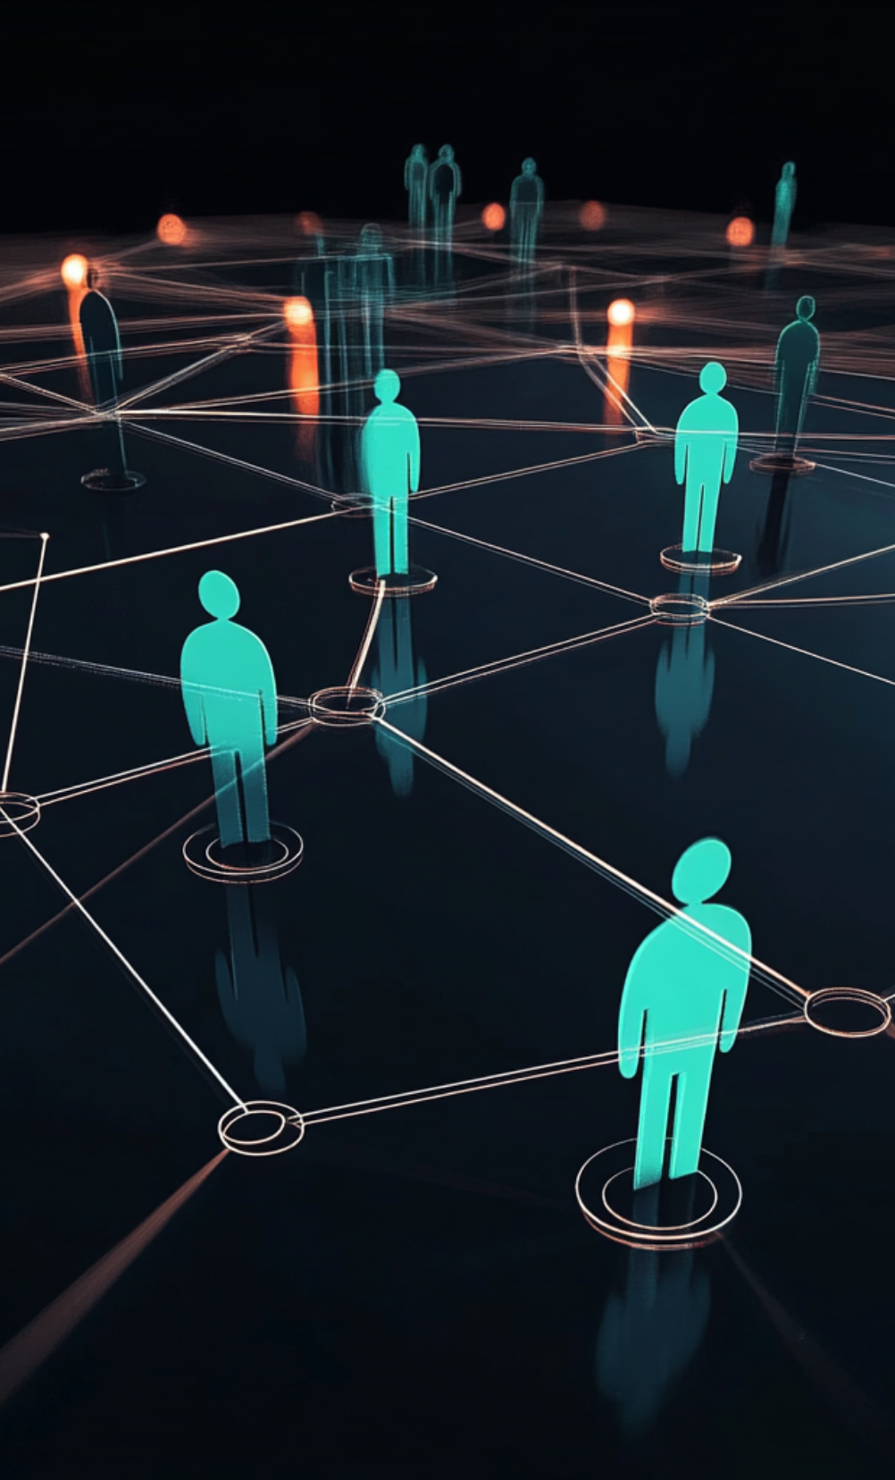
Group Members
Dipen Thaker
Sujit
Sammy
Sanjay Jangid
ePost Graduate Diploma (ePGD) in AI DS

Slide 3

Contents
1. Overview
2. Executive Summary
3. Project Stages
4. Presentation Requirements

Slide 4


Overview
The initiative aims to handle the given unlabeled and unclassified data to assign appropriate labels and extract relevant features. This processed information will then be used to create training data for developing supervised models.
Here is are the steps followed :
Data Preprocessing
Import the data set so to visualize the data and look at its shape
Transform and flatten the data to readable/interpretable 2-dimensional format
The image data set is transformed to csv eliminating the channel layer
The text data set is transformed into a simple text file for viewing the content
Unsupervised Learning
Normalize the data so to standardize it and remove any bias towards feature retention
Embed the data by retaining only the high-variance impacting features. This would reduce dimensions (Improving Speed, with almost no impact on accuracy, reducing memory usage and limited number of features covering maximum data variance)
Perform PCA for high-variance features identification (>=75% variance coverage, is just an arbitrary choice)
A plot for ‘explained variance coverage’ and a ‘scree’ helps deciding the features which covers >=75% variance
Perform t-SNE for visualizing the clusters on whole image dataset
Perform t-SNE for visualizing the clusters on PCA reduced image dataset
Supervised Model Training
Model Evaluation and Testing

Slide 5
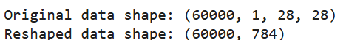
Data Processing
Import the data set so to visualize the data and look at its shape
Transform and flatten the data to a readable/interpretable 2-dimensional format
The image data set is transformed to csv eliminating the channel layer
The text data set is transformed into a simple text file for viewing the content

Slide 6
Unsupervised learning
Normalize the data so to standardize it and remove any bias towards feature retention
Embed the data by retaining only the high-variance impacting features. This would reduce dimensions (Improving Speed, with almost no impact on accuracy, reducing memory usage and limited number of features covering maximum data variance)
Perform PCA on normalized data such that to give number of features which covers >=X% variance
A plot for ‘explained variance coverage’ and a ‘scree’ helps deciding the features which covers >=X% variance
Train K-Means to cluster on PCA reduced data
Choose combination of clusters + variance-coverage giving maximum

Slide 7
Unsupervised learning
Below is the metrics and variance graph based on which the best combination of number of clusters and variance coverage is chosen so to generate the labels (Y_train)
Clusters = 8 and Variance Coverage = 95 | Clusters = 8 and Variance Coverage = 75
Clusters = 10 and Variance Coverage = 95 | Clusters = 10 and Variance Coverage = 75
Going by the metrics, 8 clusters covering 75% of variance when used in K-Means clustering on 75% PCA data having features reduced from 784 to 34, gave a Silhouette Score: 0.1099. So, we choose this combination to generate the labels (Y_train)

Slide 8

Datasets/Image Dataset
This dataset contains select examples of handwritten digits from MNIST but are unlabeled.

Slide 9

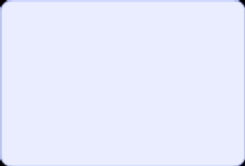
Datasets/Text Dataset
The text dataset is a collection of documents.
Each document belongs to one out of the five topics (5 clusters).
The documents are unlabeled raw text.

Slide 10

Executive Summary

Slide 11

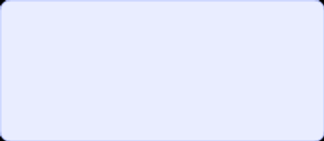
Project Summary
This project simulates the workflow of a modern unsupervised-to-supervised machine learning pipeline.
It is structured in two stages, each of which builds upon the other.

Slide 12

Thank You

